Slide 1
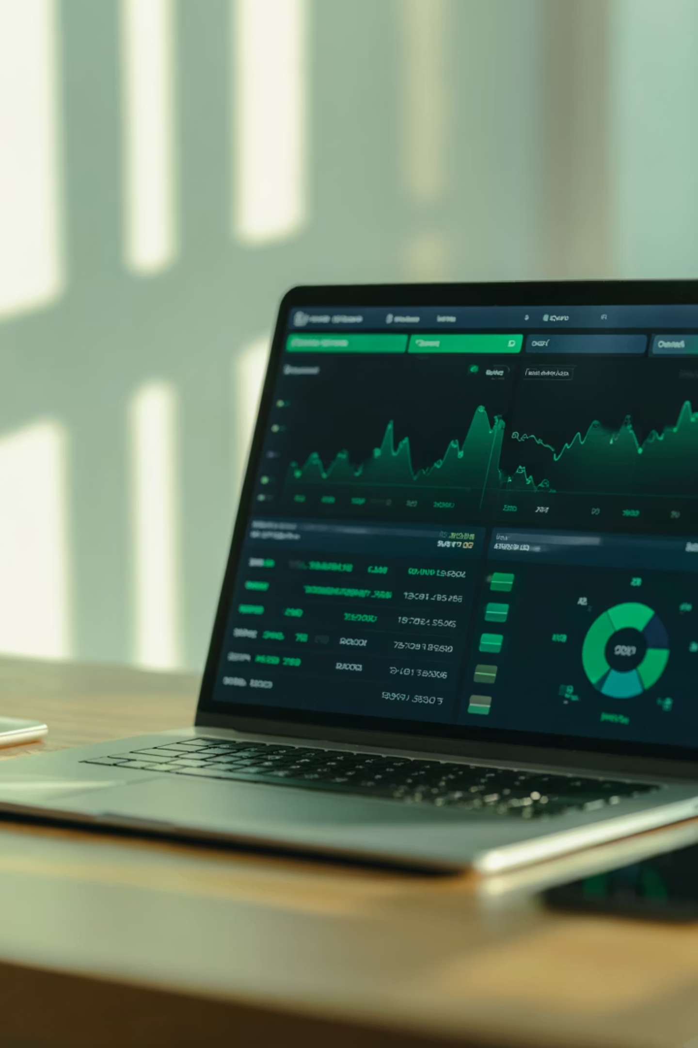
RippleWealth: AI-Driven Investment Risk Intelligence Platform
Sprint 3 Deliverable:
Computer Science Capstone Project CS 691
Prof. Kshitij Sharma • Spring 2026
Group 8:
Sharvani Kadarla • Deepali Sawant • Jai Sheel Bhasker Paladugu • Ashish Reddy Majjigapu

Slide 2
Agenda
Team Member Roles & Responsibilities
Improvements from Professor Feedback
Problem Statement
Project Description
Team Working Agreement
Personas
Minimum Viable Product (MVP)
System Design & Technologies
Algorithms Used
System Diagrams
Sprint 2 Recap
Product Backlog
Sprint Summary (Sprint 0, 1, 2)
Sprint 3 Backlog
Test Cases (Sprint 3)
Sprint Metrics
Sprint Retrospective
Project Demonstration
GitHub Repository & Technical Paper
Live Application

Slide 3
Team Member Roles and Responsibilities
Our project success hinges on a clearly defined structure, where each team member's expertise drives specific outcomes.
Sharvani Kadarla
Deepali Sawant
Project Manager & Software Developer
Frontend & Visualization Engineer
Define project vision, roadmap, and milestones
Plan sprints and coordinate team tasks
Design system architecture and data flow
Ensure integration across all modules
Monitor progress and resolve blockers
Develop interactive UI and dashboards
Build portfolio and knowledge graph visualizations
Ensure clean, user-friendly UI/UX design
Integrate frontend with backend APIs and AI outputs
Jai Sheel Bhasker Paladugu
Ashish Reddy Majjigapu
AI / Machine Learning Engineer
Backend & Data Engineering Lead
Develop AI models for event impact analysis
Build causal graphs for industry and company effects
Implement LLM-based explainable insights
Run scenario simulations for portfolio risk analysis
Develop RESTful APIs using FastAPI
Build data ingestion and preprocessing pipelines
Manage data storage and validation
Support portfolio risk calculations and backend performance

Slide 4

Improvements Made From Professor's Feedback
After reviewing the professor's feedback on our sprint evaluation, we identified the need to improve planning, prioritization, and timely task completion.
Better Sprint Planning
Improved Scheduling & Retrospectives
Refined user stories and personas to better reflect target user needs, enabling clearer task prioritization and more effective assignment of responsibilities early in the sprint cycle.
Optimized sprint timelines and task distribution for consistency across deliverables, and strengthened retrospectives by capturing key insights, challenges, and improvements to support continuous agile progress.
Progress Tracking
Enhanced Communication
Introduced clear internal deadlines and improved milestone tracking to ensure timely progress and prevent delays during Sprint 3 execution.
Strengthened communication through regular meetings and status updates, resolving blockers quickly
These improvements helped the team maintain better alignment, accountability, and more efficient sprint execution for the RippleWealth project.

Slide 5

Problem Statement
Reactive, Not Proactive
Modern investment platforms alert investors only after stock prices change, missing early warning signals
Ignored Risk Triggers
Current tools focus mainly on financial indicators and ignore non-financial risk triggers like supply chain disruptions, weather events, labor strikes, or logistics delays
Lack of Clear Explanations
Investors lack clear explanations of why their portfolio risk is increasing and cannot anticipate risk or make proactive portfolio decisions

Slide 6

Project Description
RippleWealth is an AI-driven investment risk intelligence platform that anticipates market risks by detecting real-world disruptions—such as weather events, supply chain delays, and labor strikes—before they appear in stock prices. Unlike traditional investment tools that react only after price changes, RippleWealth provides early insights to help investors understand potential portfolio impacts.
Using a multi-agent AI architecture and LLM-based causal reasoning, the platform maps how these events propagate across industries and impact companies and portfolios. Through an interactive Knowledge Graph and explainable risk metrics like Value-at-Risk (VaR), RippleWealth enables proactive, transparent, and data-driven portfolio risk management.

Slide 7
Team Working Agreement
Participation
Meetings
Attend scheduled meetings on time
Come prepared with progress updates
Inform the team leader in advance if absent
Weekly meetings via Zoom / Google Meet
Team leader schedules and shares meeting links
Meeting minutes recorded after each session
Work Quality & Collaboration
Work Division & Ownership
Share work early for feedback
Maintain professionalism and accountability
Ensure alignment with project goals
Tasks assigned during sprint planning
Equal responsibility among team members
Meet agreed deadlines and communicate blockers early
Communication Tools
Team Transparency
Zoom / Google Meet – Sprint meetings
WhatsApp – Quick updates and urgent communication
Google Docs & Slides - Collaborative deliverables
Cameras encouraged during meetings
Maintain open communication and team trust

Slide 8

User Persona 1: Ethan Miller
Young Professional & Retail Investor
Goals
Understand Value-at-Risk clearly
Simulate market crash scenarios
Get simple portfolio risk scores
Improve long-term returns
Make safer investment decisions
Frustrations
Cannot clearly measure portfolio risk
Hard to understand downside scenarios
Too many scattered finance tools
Confusing probability models
Lacks simple visual risk insights
Interests
Age: 29 Location: Austin, Texas Job: Software Engineer Salary: $95K–$120K/year Family: Lives with partner Investment Level: Beginner to Intermediate
Personal finance and investing • Portfolio tracking apps • Market trend analysis • Tech and automation tools • Financial podcasts • Long-term wealth building

Slide 9

User Persona 2: Sophia Chen
Financial Risk Analyst (Professional)
Goals
Run large-scale Monte Carlo simulations
Identify systemic risk pathways
Model inter-company relationships
Generate client risk reports quickly
Improve predictive accuracy
Frustrations
Manual scenario modeling is time-consuming
Tools lack integrated causal analysis
Hard to map indirect market impacts
Needs faster simulation turnaround
Limited explainability in some models
Interests
Age: 38 Location: New York, NY Job: Financial Risk Analyst Salary: $130K–$160K/year Family: Married, one child Investment Level: Advanced / Professional
Risk modeling techniques • Market stress testing • Portfolio optimization • Quantitative finance • Economic indicators • Financial data visualization

Slide 10

User Persona 3: Carlos Ramirez
Business Owner & Wealth Planner
Goals
Understand event → market → portfolio impact
Visualize causal financial relationships
Stress-test business investments
Reduce exposure to high-risk sectors
Make resilient investment plans
Frustrations
Unsure how world events affect investments
No clear impact chain visibility
Market shocks feel unpredictable
Hard to evaluate sector dependencies
Lacks scenario-based planning tools
Interests
Age: 45 Location: Atlanta, Georgia Job: Small Business Owner Salary: $110K–$150K/year Family: Married Investment Level: Moderate Investor
Business growth strategy • Market and sector trends • Supply chain news • Financial planning tools • Diversified investments • Economic forecasts

Slide 11
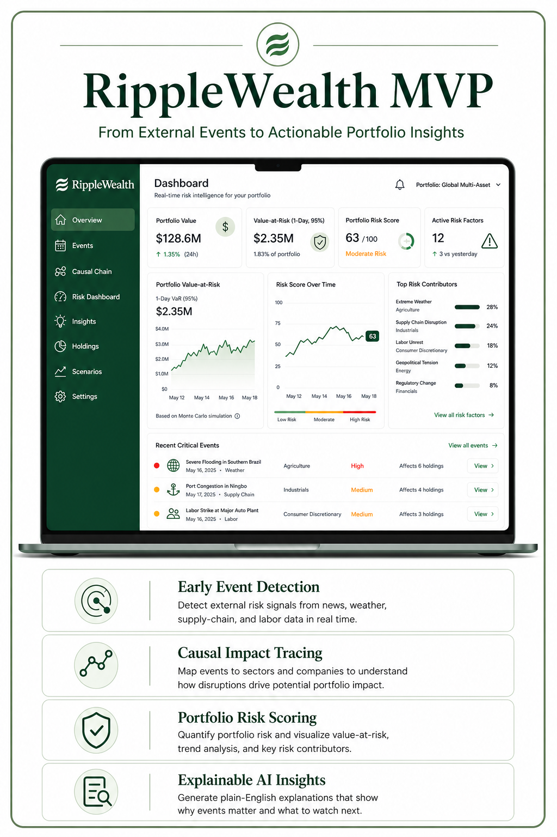
Minimal Viable Product (MVP)
Alternative Data Engine
Modern investment platforms often alert investors only after stock prices change, which can cause early warning signals to be missed.
Ripple Wealth detects external risk signals from news, weather, supply-chain disruptions, and labor events using keyword filtering and NLP.
Portfolio Risk Dashboard
Displays Value-at-Risk, portfolio risk scores, and scenario-based analysis using Monte Carlo simulation.
Explainable Insights
Generates plain-English explanations showing how detected events influence holdings and overall portfolio risk.

Slide 12
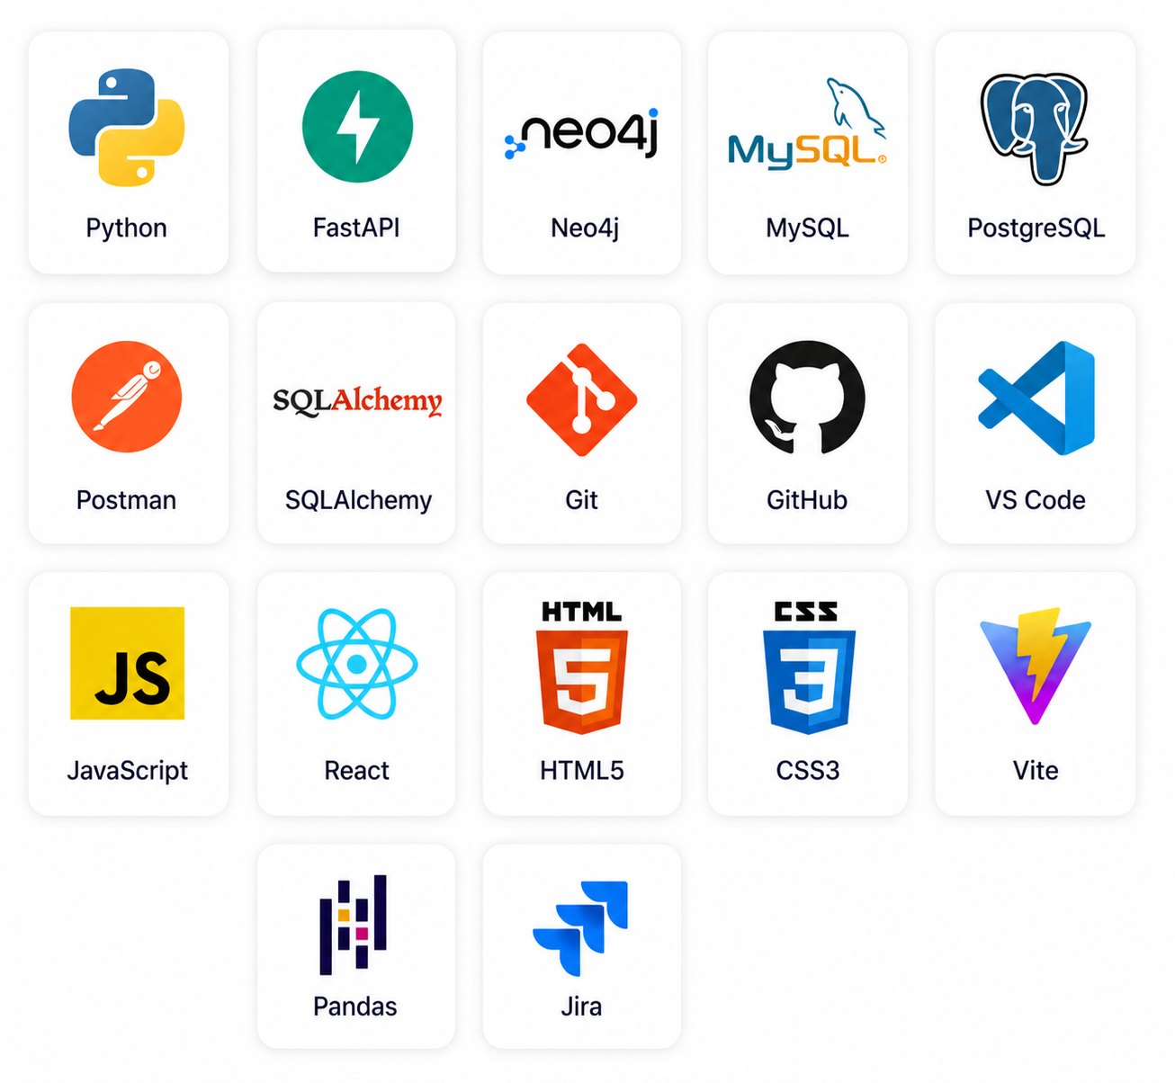
Core Technologies Powering Our Platform
AI / Analytics
Python, Monte Carlo simulation, Value-at-Risk, and keyword NLP support early-event detection and portfolio risk modeling.
Backend APIs
FastAPI powers REST endpoints for portfolio data, event processing, risk scoring, and frontend integration.
Frontend
React.js, JavaScript, HTML5, and CSS3 support the dashboard, interaction flow, and visual components.
Graph Technology
Neo4j supports impact tracing and causal relationship visualization across sectors, companies, and holdings.
Development Tools
Git, GitHub, Postman, VS Code, and Jira support version control, API testing, development, and sprint management.

Slide 13
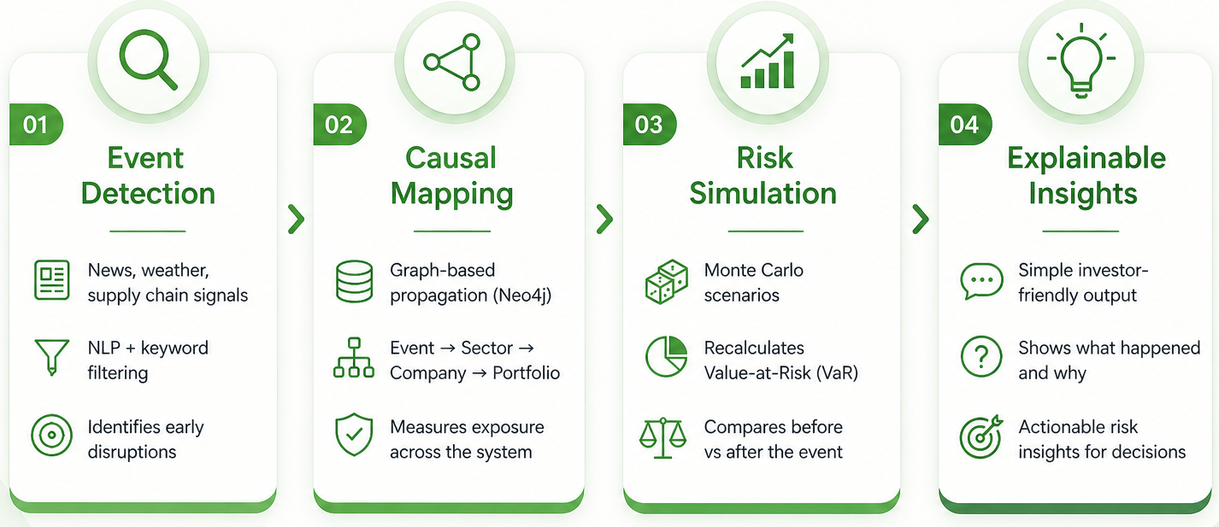
Algorithms

Slide 14
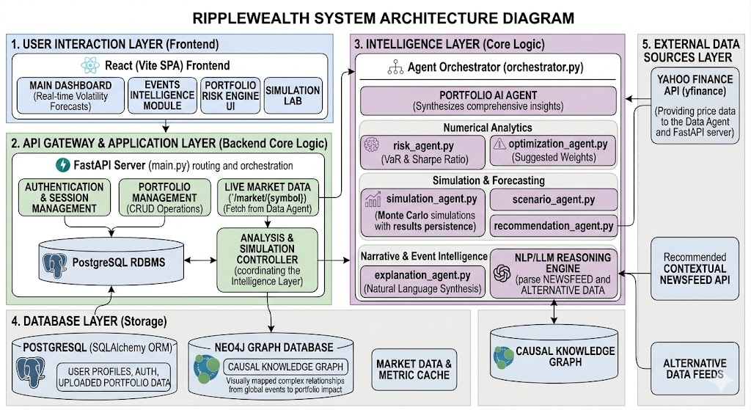
System Architecture Diagram

Slide 15
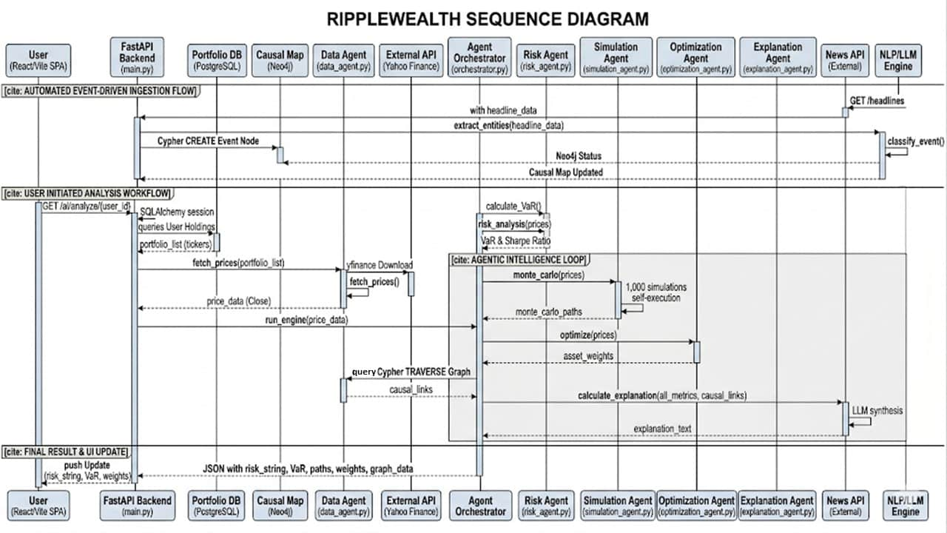
Sequence Diagram

Slide 16
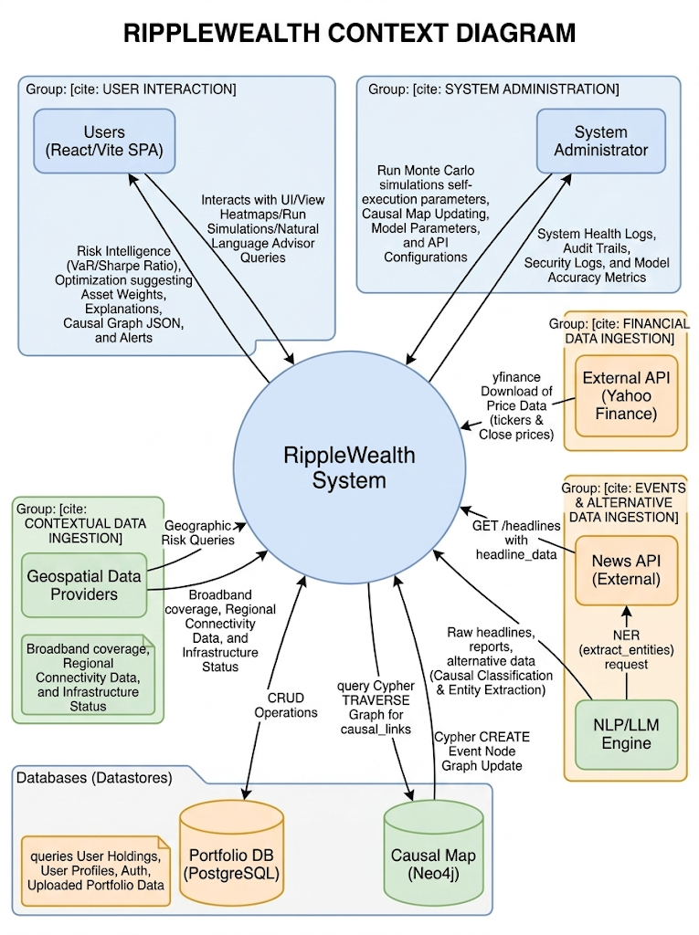
Context Diagram

Slide 17
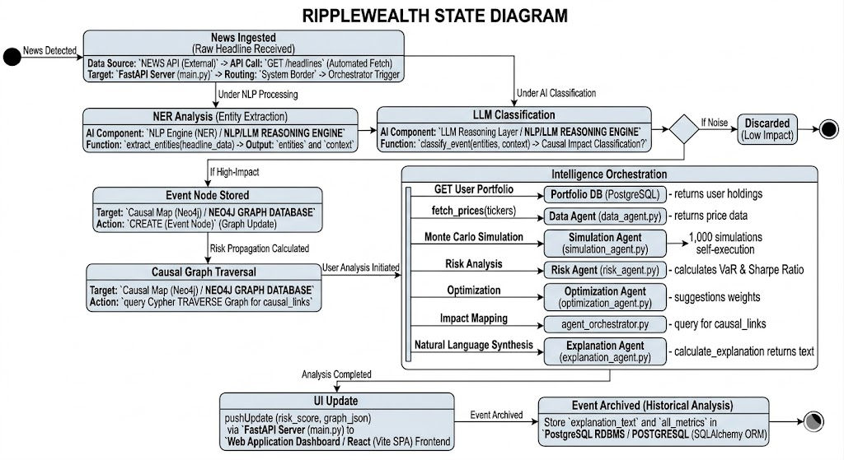
State Diagram

Slide 18
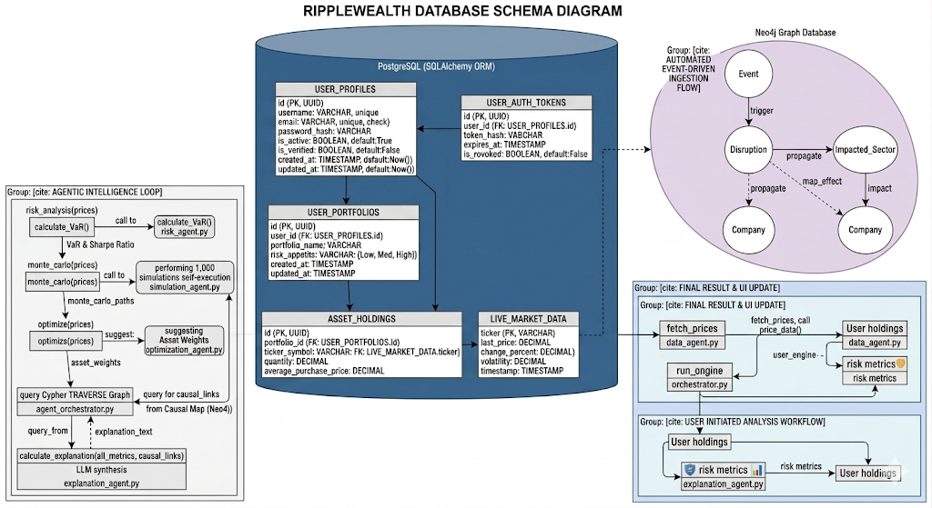
Database Diagram

Slide 19
Sprint 2 Recap
Sprint Goal:
Deliver a fully integrated RippleWealth platform with responsive UI, live event-driven simulation, end-to-end API connectivity
Work Completed:
Setup FastAPI Project & Database Models
Knowledge Graph Visualization Structure
AI–Backend Integration
Key Features:
End-to-end authentication — register, login, and persistent session across page refreshes
Centralised risk dashboard with sector allocation bars, KPI cards, and metric cards
Error handling
Natural language risk explanations generated for every analysis run

Slide 20
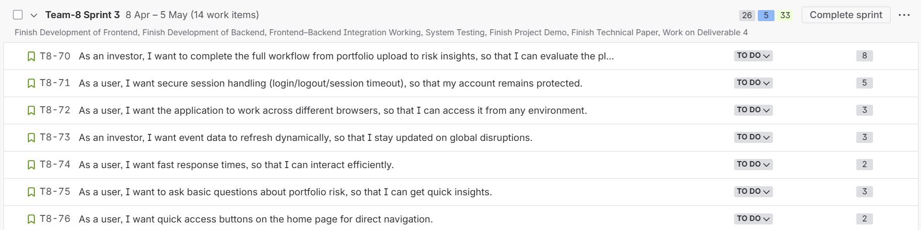
Product Backlog - User Stories

Slide 21
Acceptance Criteria
Issue Type
ID
Summary
Scenario
Acceptance Criteria
T8-70
As an investor, I want to complete the full workflow from portfolio upload to risk insights, so that I can evaluate the platform end-to-end.
Given I am a logged-in investor
When I upload a portfolio file and navigate through all workflow steps
Then I receive complete risk insights without errors
As a user, I want secure session handling (login/logout/session timeout), so that my account remains protected.
Given I am a registered user
When I log in, remain idle, or explicitly log out
Then my session is protected and terminated appropriately
Acceptance Criteria
T8-71
Acceptance Criteria
T8-72
As a user, I want the application to work across different browsers, so that I can access it from any environment.
Given I am using a supported browser
When I access the application
Then all features render and function correctly
As an investor, I want event data to refresh dynamically, so that I stay updated on global disruptions.
Given I am viewing the disruption events dashboard
When new event data becomes available
Then the dashboard updates without requiring a manual page refresh
Acceptance Criteria
T8-73
As a user, I want fast response times, so that I can interact efficiently.
Given I am interacting with any part of the application
When I perform an action (navigation, search, load)
Then the system responds within acceptable time thresholds
Acceptance Criteria
T8-74
As a user, I want to ask basic questions about portfolio risk, so that I can get quick insights.
Given I am on the portfolio agent page and my portfolio data is available
When I enter a question about portfolio risk (e.g., “What is my risk exposure?”)
Then I receive a relevant response explaining the portfolio risk based on available data
Acceptance Criteria
T8-75
As a user, I want quick access buttons on the home page for direct navigation.
Given I am on the home page
When I view the quick access section
Then I can navigate directly to key features with a single click
Acceptance Criteria
T8-76

Slide 22

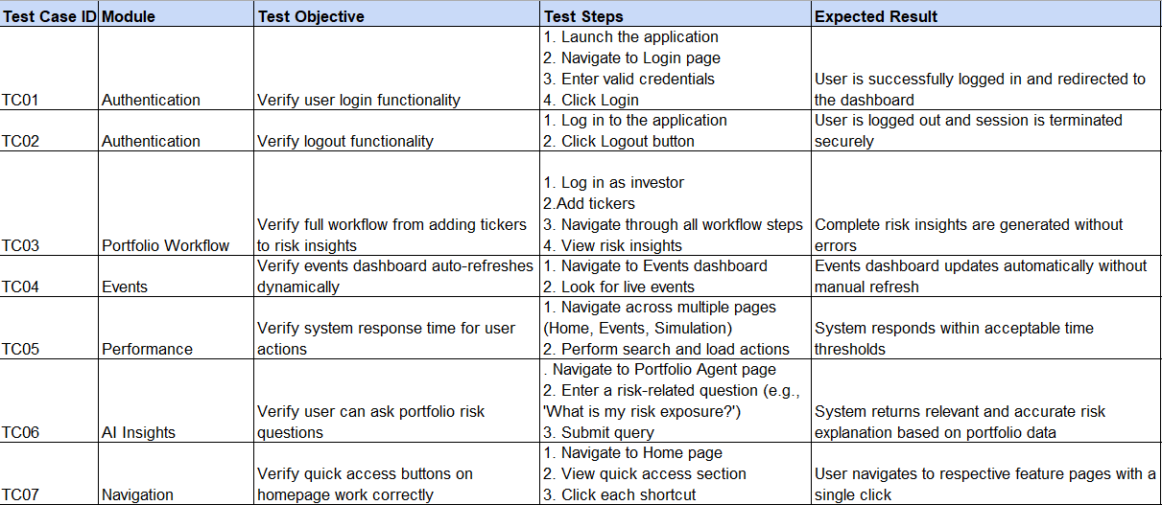
Test Cases

Slide 23
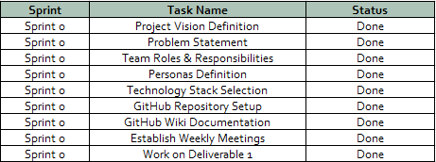
Sprint Summary: Sprint 0

Slide 24
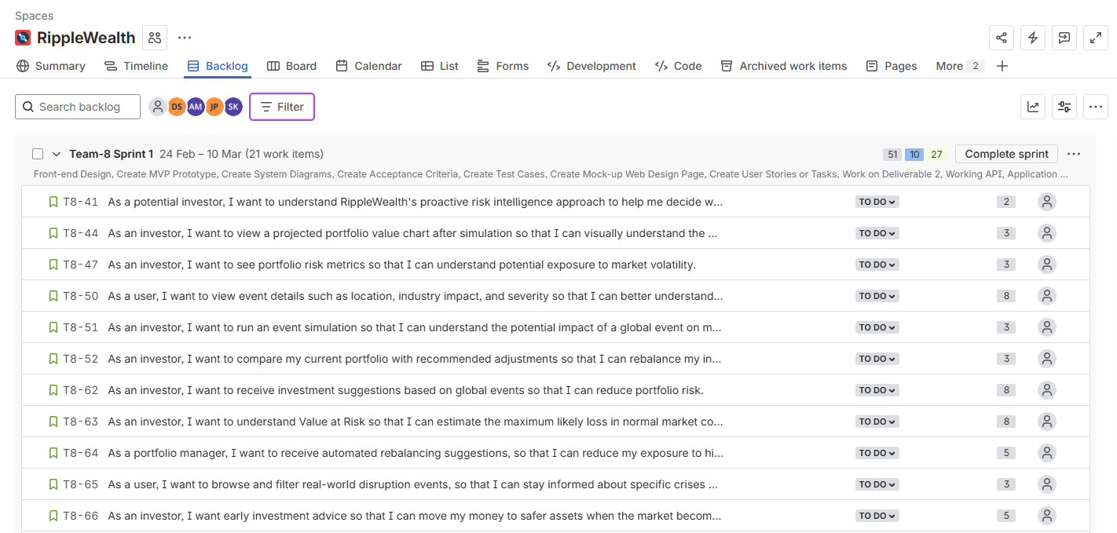
Sprint Summary: Sprint 1 User Stories

Slide 25
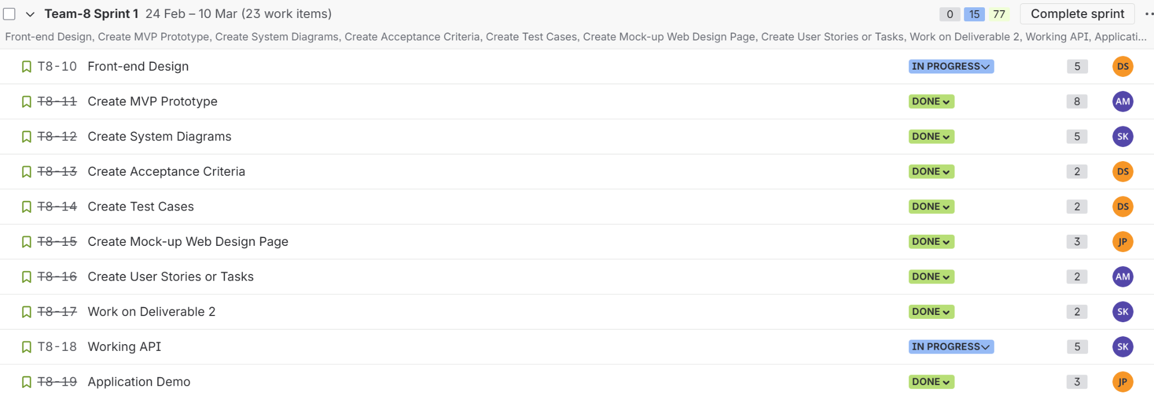
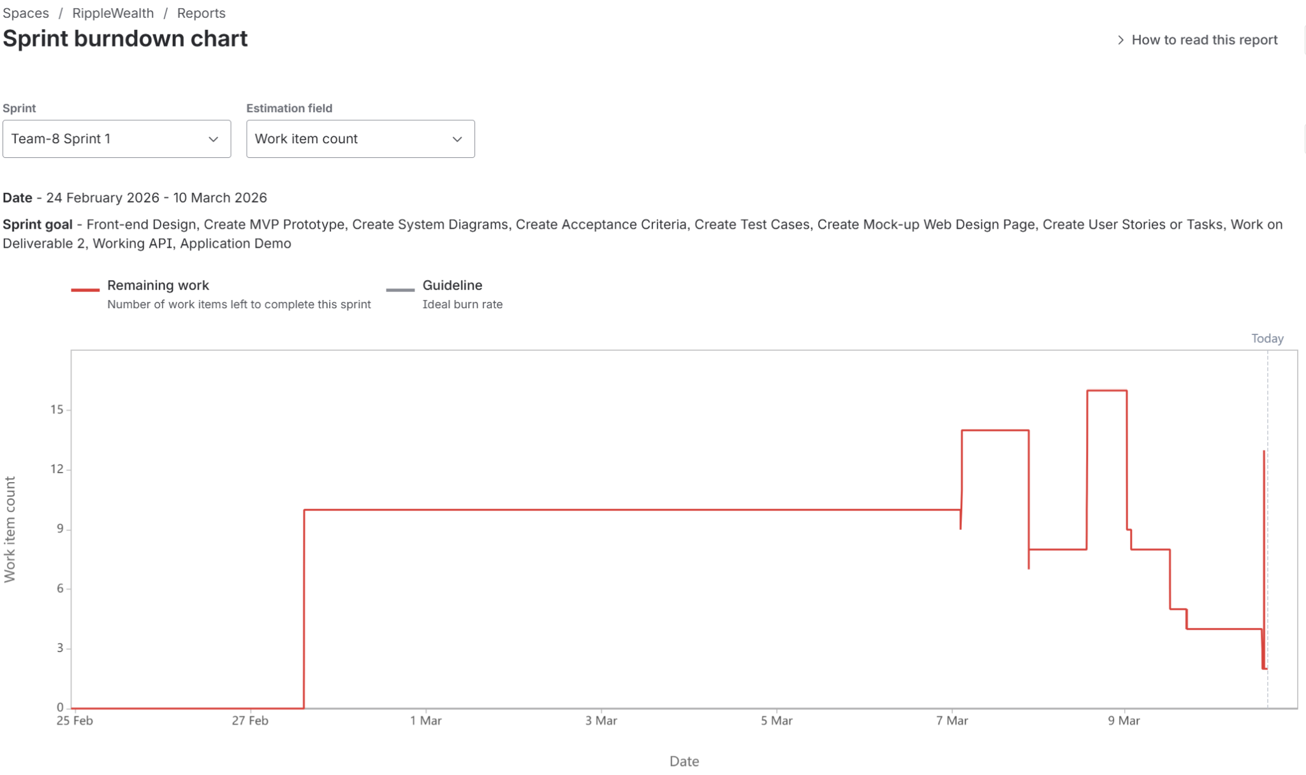
Sprint Summary: Sprint 1 Tasks and Burndown Chart

Slide 26
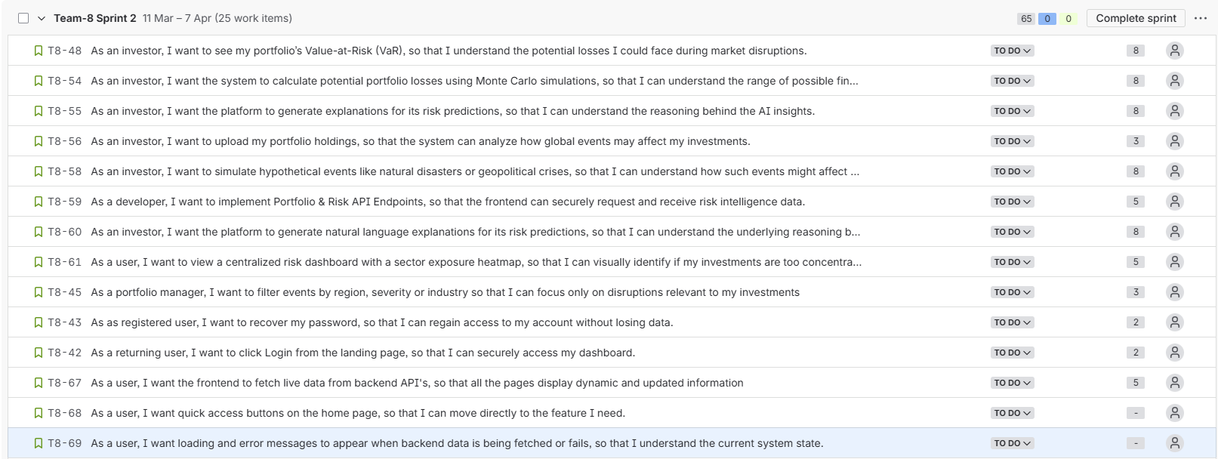
Sprint Summary: Sprint 2 User Stories

Slide 27
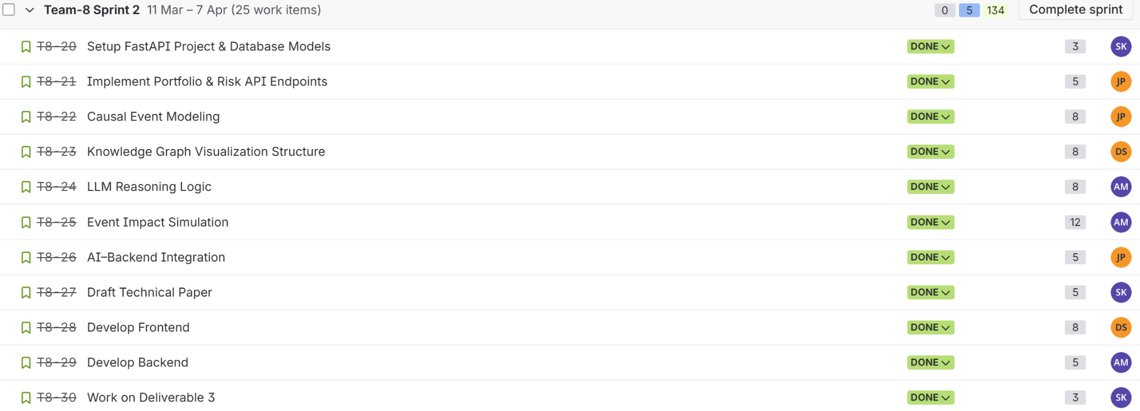
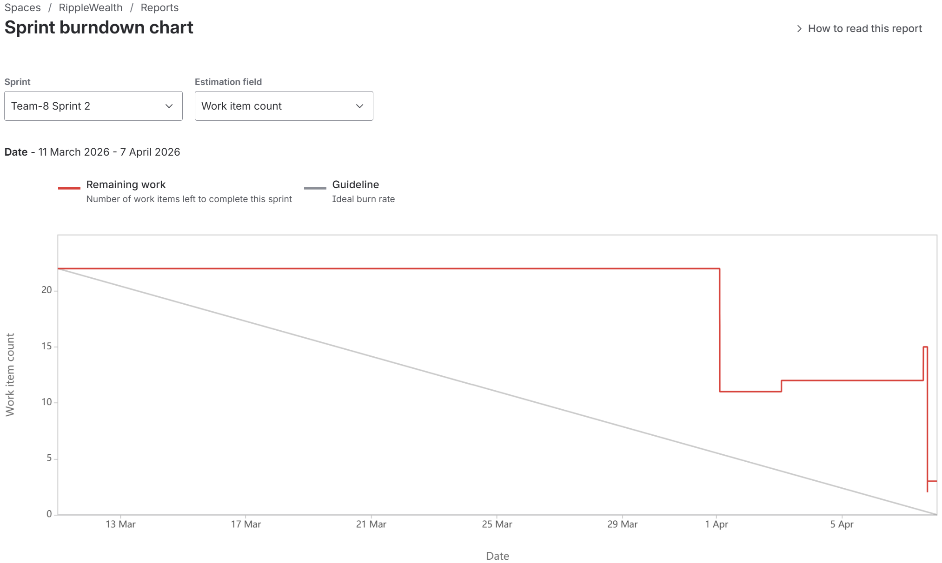
Sprint Summary: Sprint 2 Tasks and Burndown Chart

Slide 28
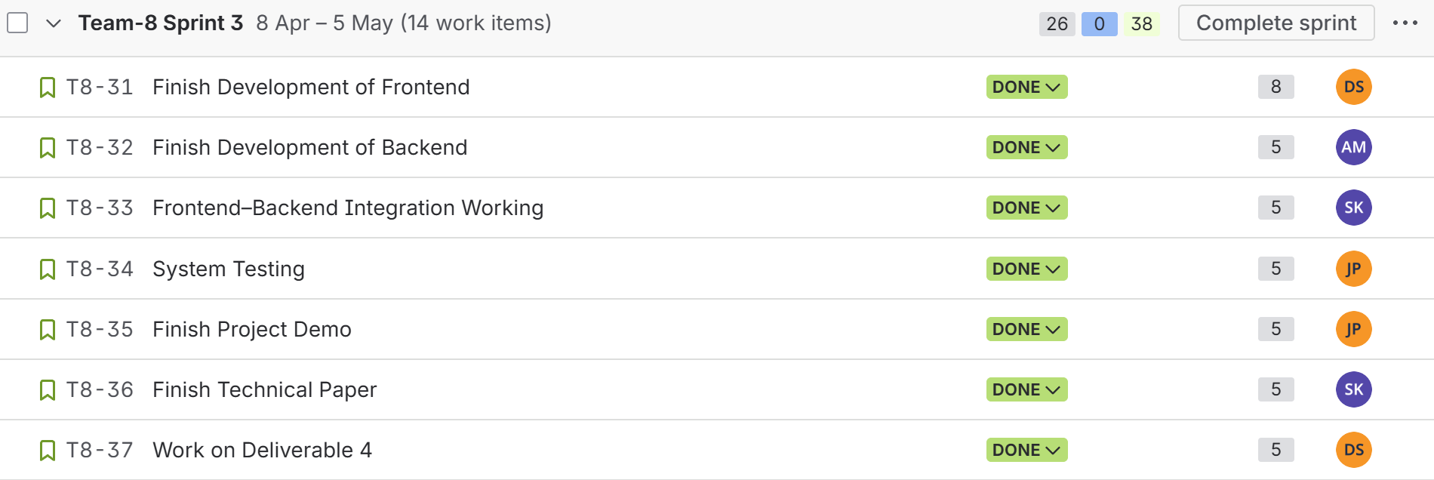
Sprint Backlog: Sprint 3

Slide 29
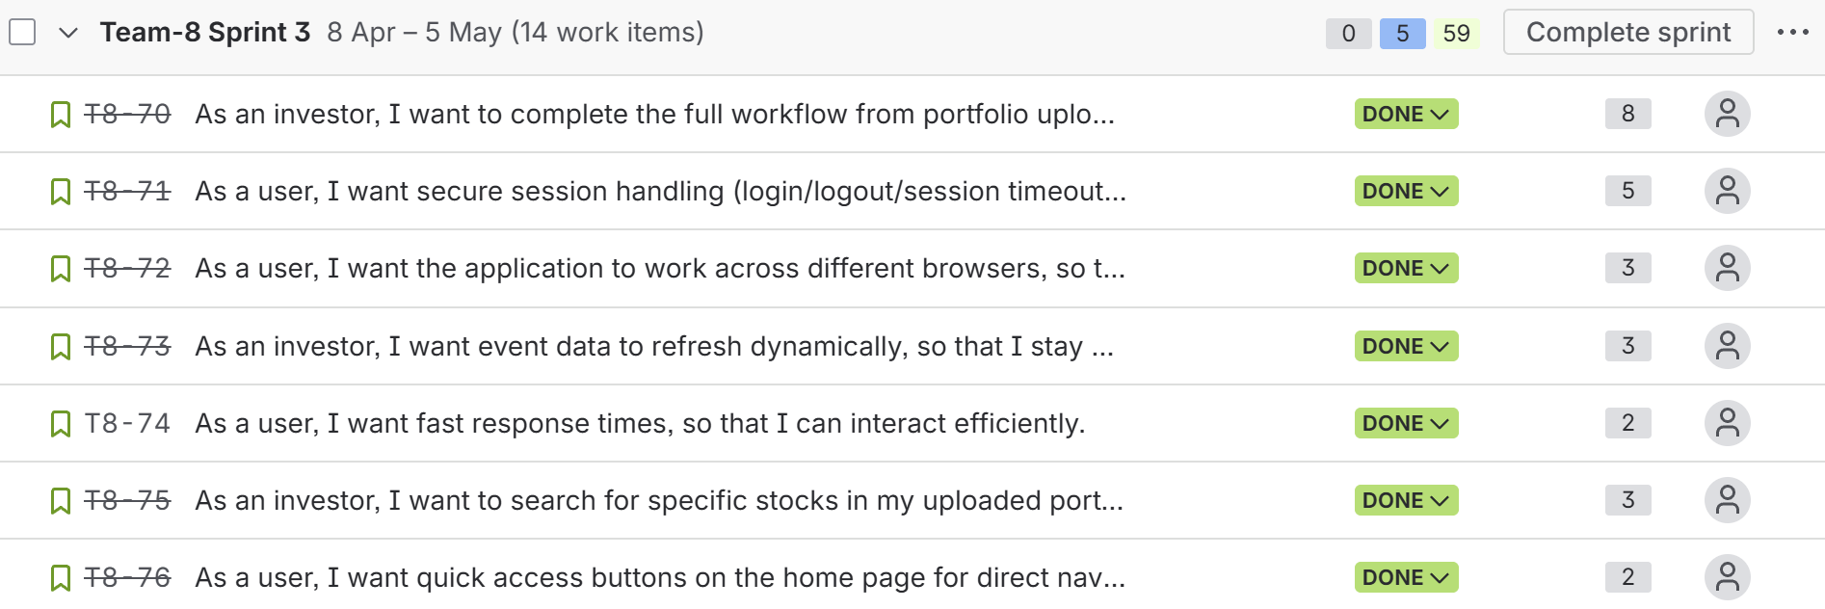
Stories Completed - Sprint 3

Slide 30
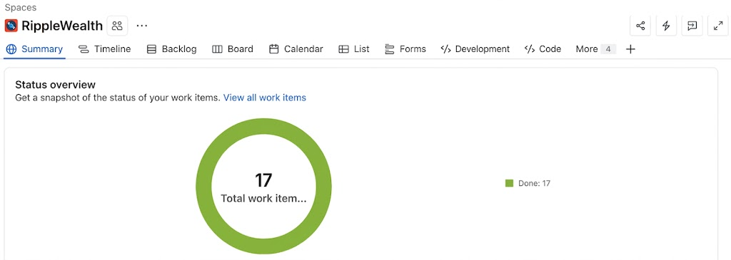
Metrics - Status Overview as of Sprint 3

Slide 31
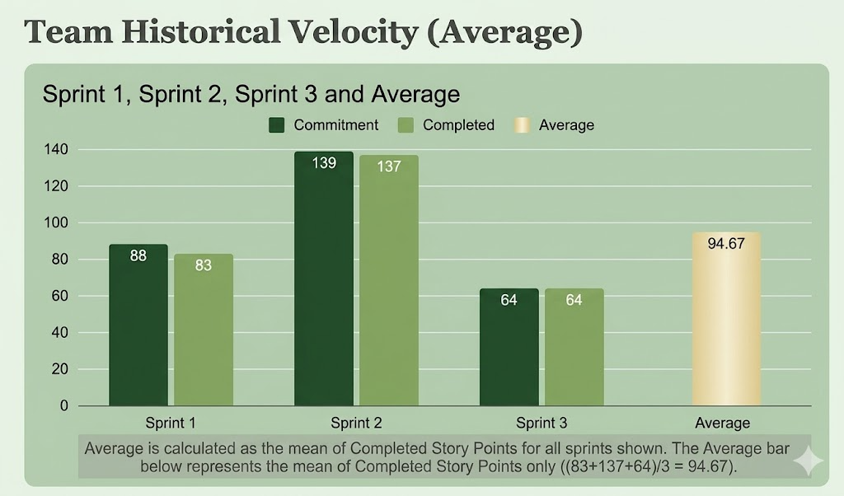
Metrics - Team's Historical Velocity (Average)

Slide 32
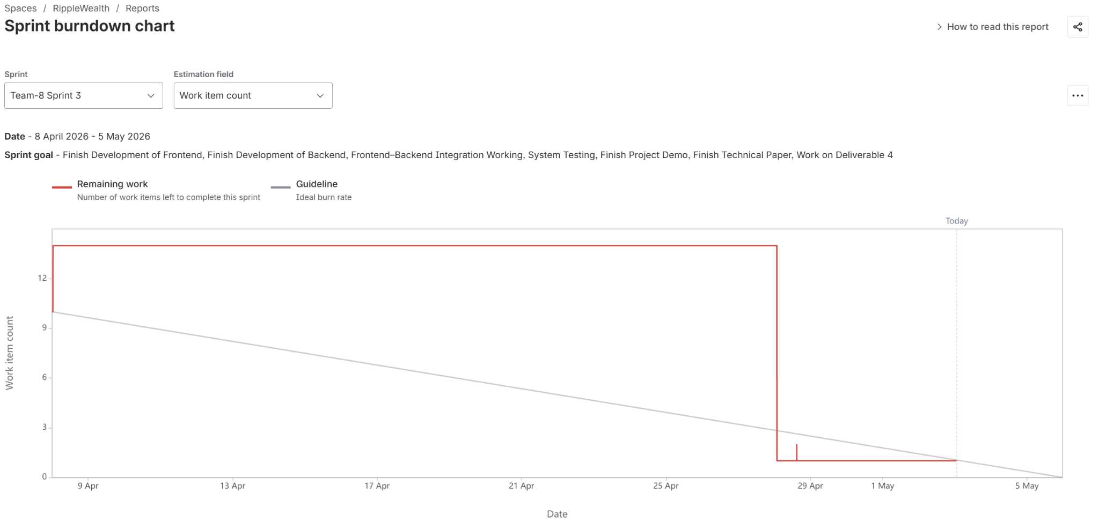
Metrics - Sprint 3 Burndown Chart

Slide 33
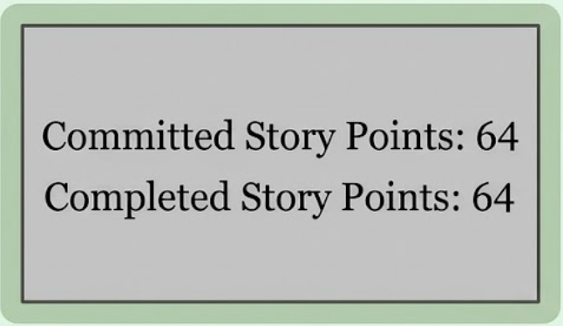
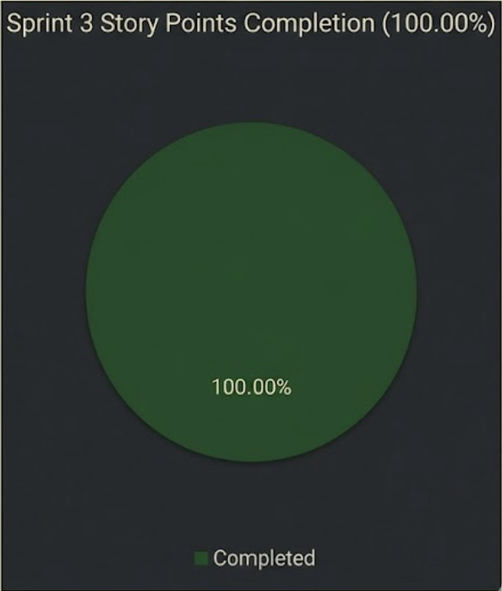
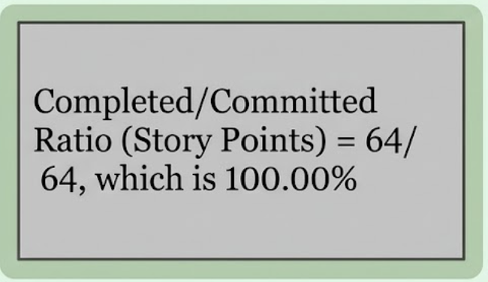
Metrics - Sprint 3 Ratio Status

Slide 34

Retrospective
WHAT WENT WELL
Event Adjusted Simulation:
Knowledge Sharing Across Roles
Integrating live market events directly into scenario projections gave the application a differentiated capability.
Frontend and backend members actively helped each other debug integration issues rather than working in silos.
Live Events Feed:
AI Analysis End-to-End:
The dual auto-scrolling marquee with category tagging and impact ratings shipped polished and on time, and the hover-to-pause interaction works smoothly.
The full pipeline from user holdings → yfinance price data → Sharpe, VaR, optimised weights → written AI explanation shipped completely and correctly within the sprint.

Slide 35
Retrospective
WHAT NEEDS IMPROVEMENT
Task Granularity and Estimation:
Spreading Integration Work Throughout the Sprint:
Complex technical stories were taken on without being broken into smaller sub-tasks. This made it difficult to track progress mid-sprint.
Integration between the frontend and backend tended to happen toward the end of the sprint. Doing small integration checks more regularly throughout the sprint would make the final days feel much less pressured and give more time to polish.

Slide 36

Project Demo - Sprint 3

Slide 37
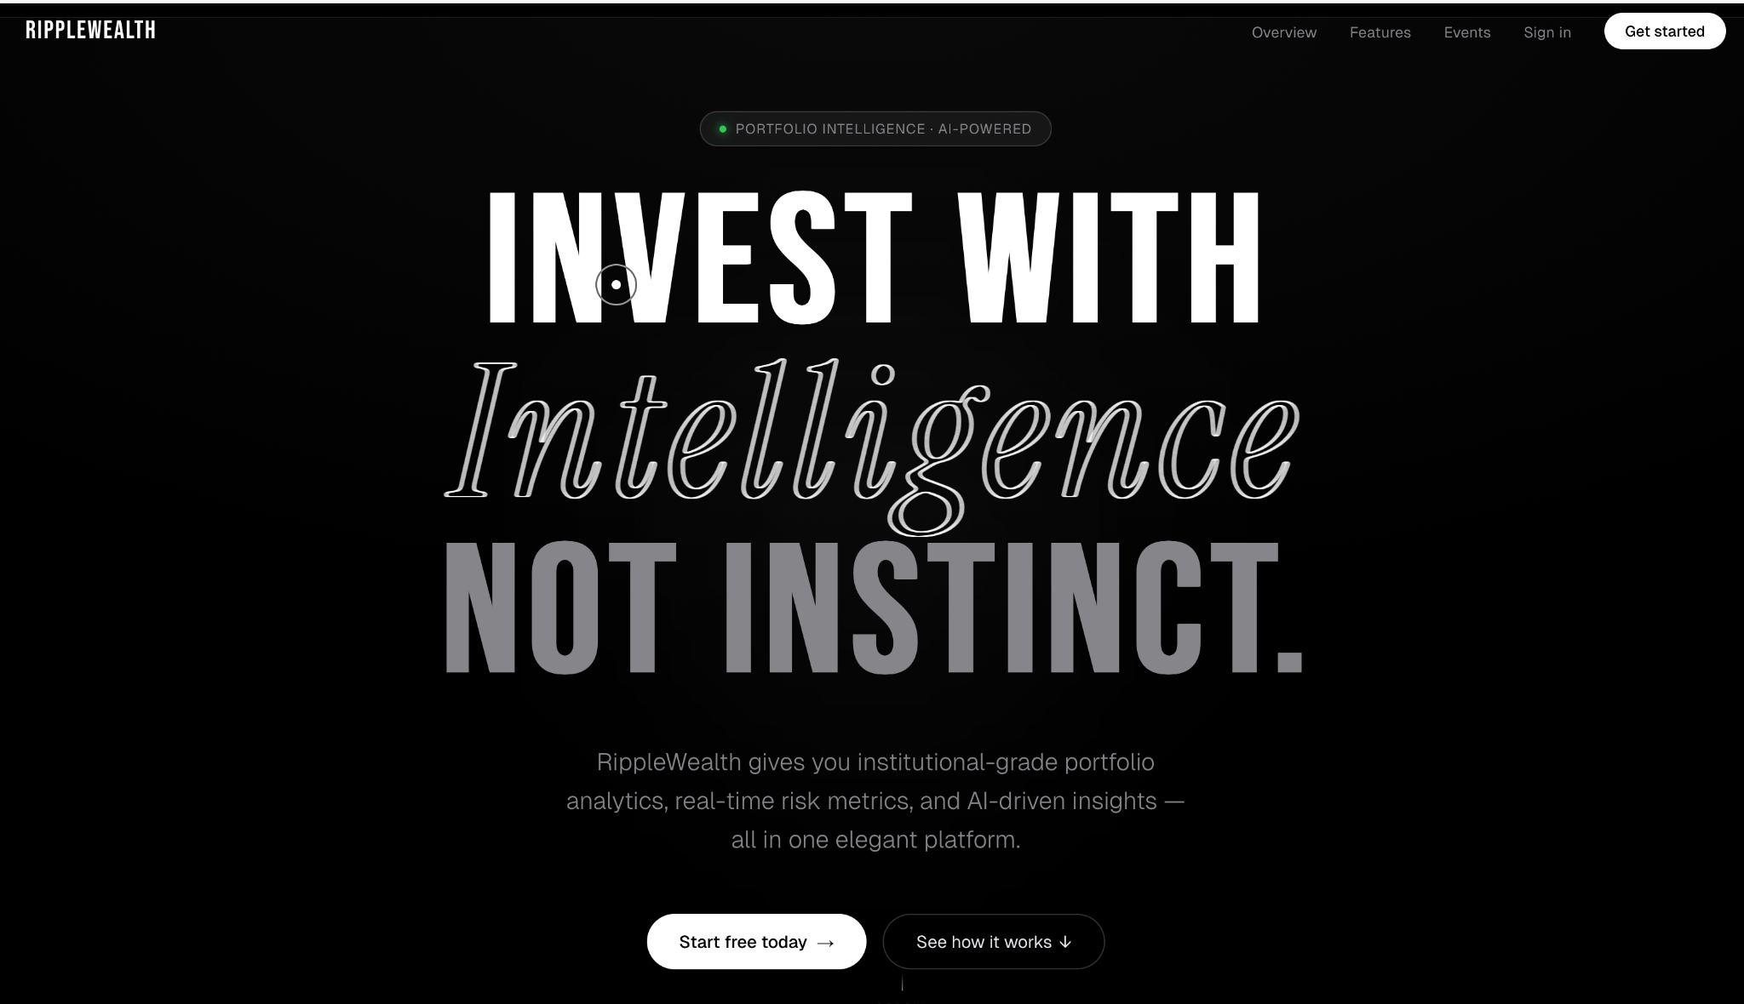
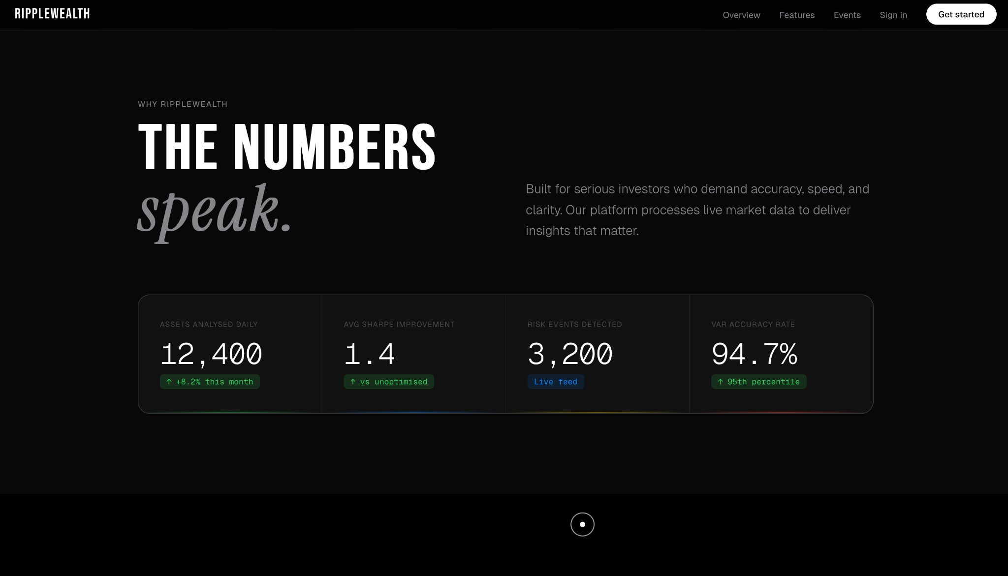
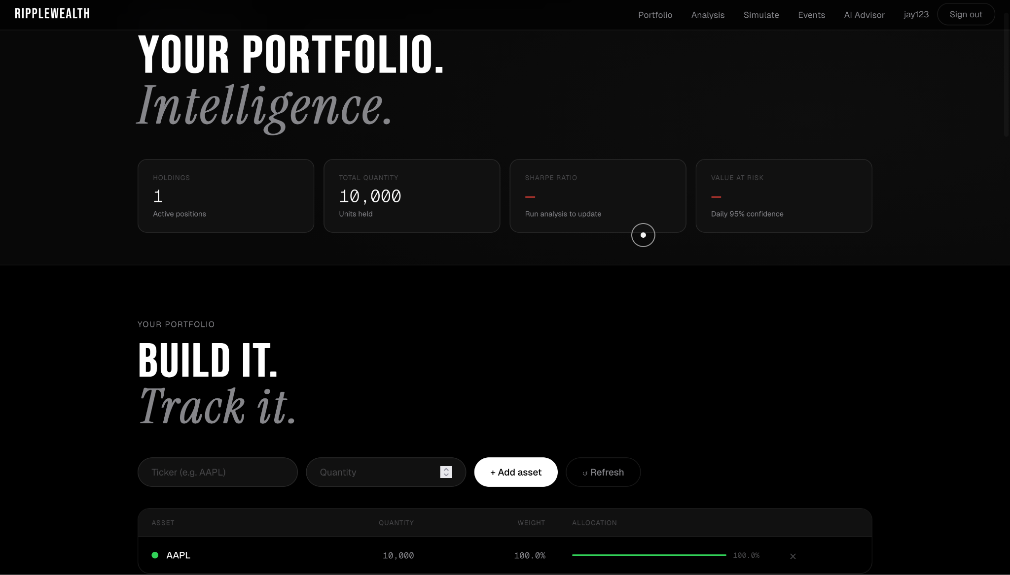
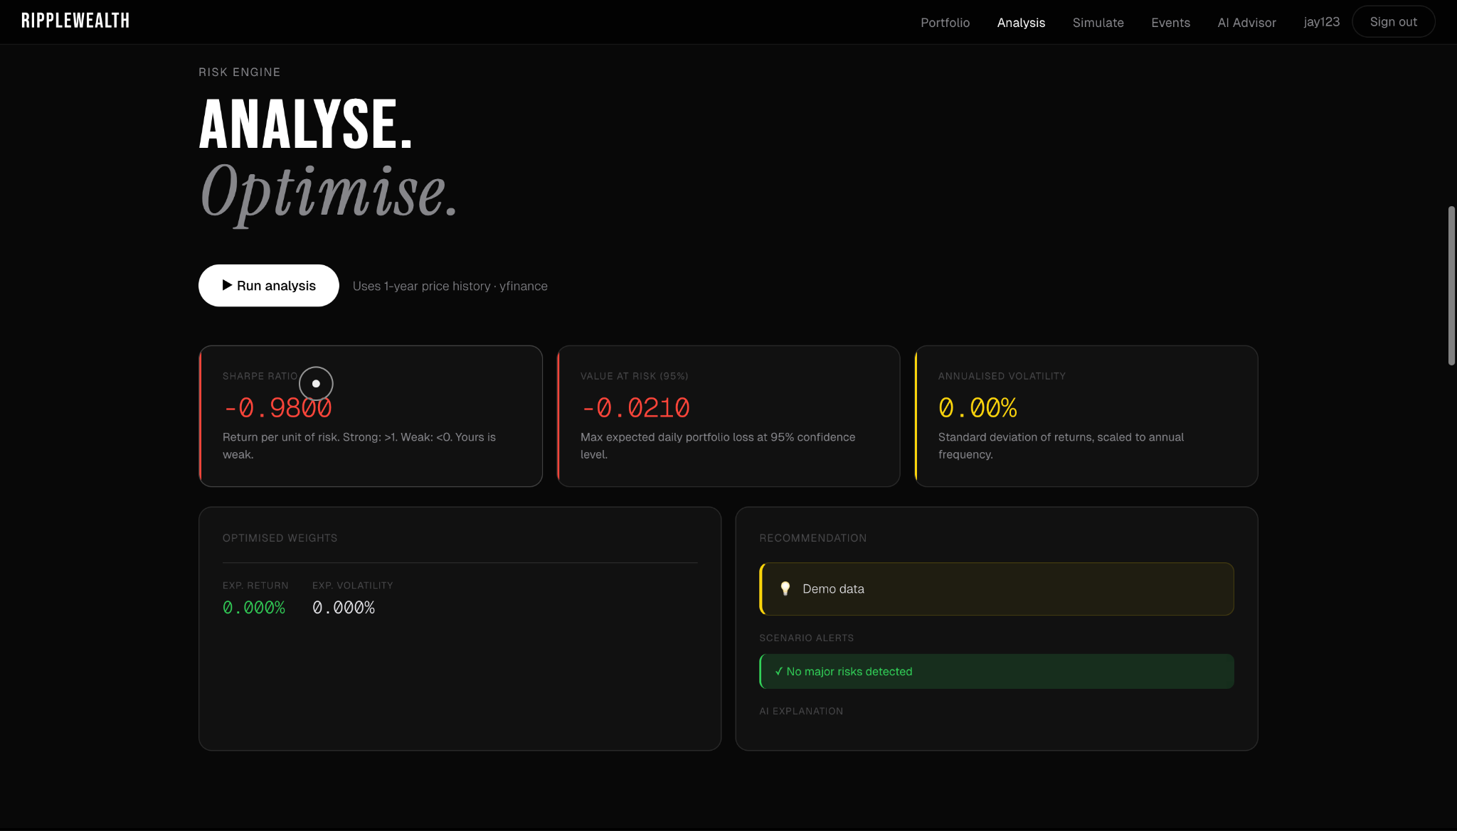
Application Screenshots

Slide 38
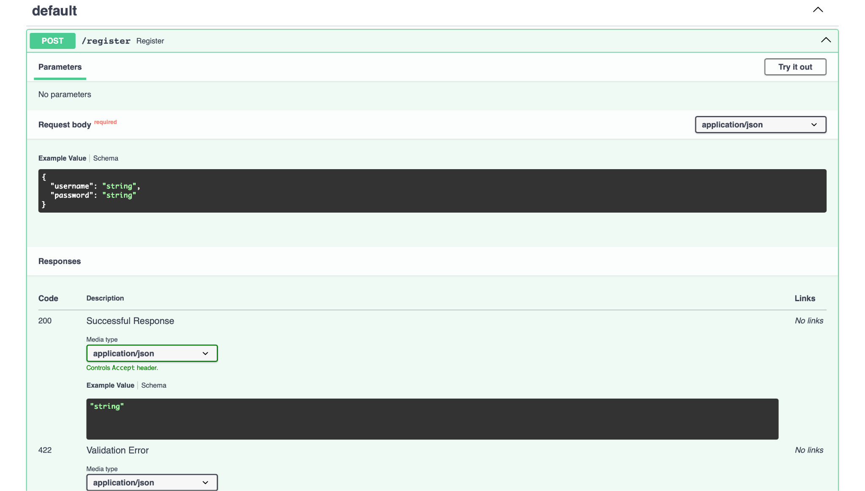
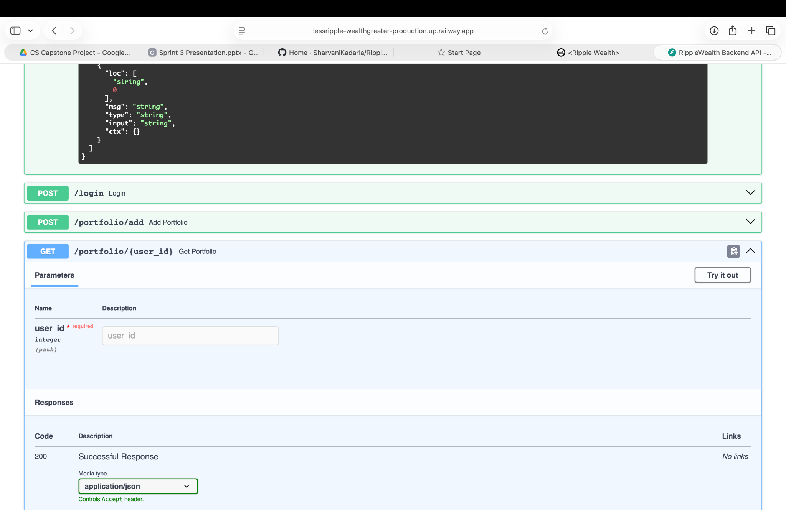
Working API Screenshots

Slide 39
Live Application Demo

Slide 40


GitHub Wiki Page Link
SharvaniKadarla/RippleWealth Wiki Page (github.com)

Slide 41


Technical Paper Link
RIPPLEWEALTH TECHNICAL PAPER (GITHUB.COM)

Slide 42
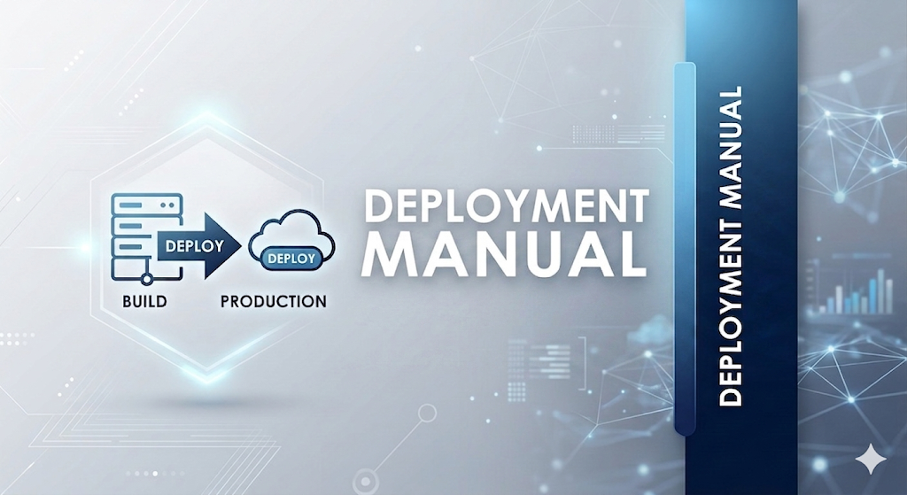
Deployment Manual Link
RIPPLEWEALTH DEPLOYMENT MANUAL (GITHUB.COM)

Slide 43

API Documentation Link
RIPPLEWEALTH API DOCUMENTATION (GITHUB.COM)

Slide 44
THANK YOU

